Slide 1
KUOBROTHERS CORP.
Stock Code: 8477
Investor Conference
December 23, 2022

Slide 2
Disclaimer
Information provided in this presentation may contain forward-looking statements. Such statements of current expectations are subject to known and unknown risks or uncertainties, and actual results may differ materially from those contained in the forward-looking statements.
Except as required by law, we undertake no obligation to update any forward-looking statement, whether as a result of new information or future events.

Slide 3
Company Profile
Establishment: May, 2012
No. of employees: 130
Business Office: Taipei Nangang Software Park
Primary Services: E-commerce services including Buy123, MobiX and etc.

Slide 4
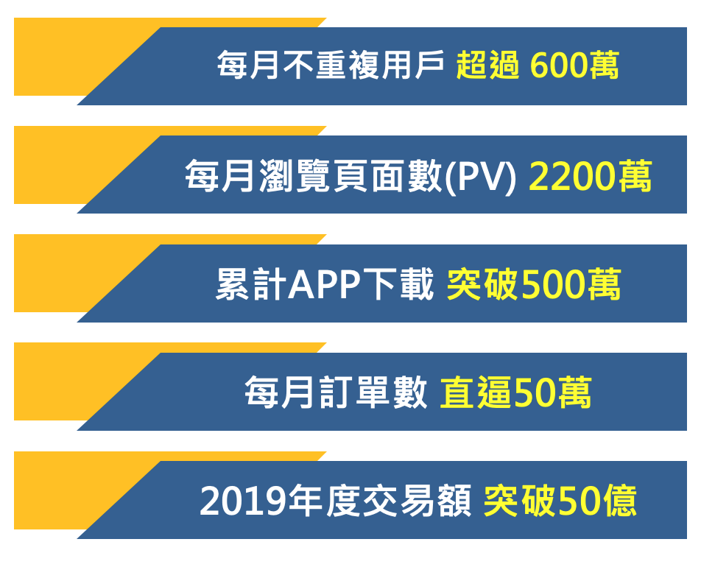
2019
Won the Digital Singularity Award (DSA)
Best Digital Technology Application
Named the best digital technology application in the Digital Singularity Awards.
No. of monthly unique visitors over 6 million
No. of monthly page views (PV) 22 million
No. of cumulative APP downloads over 5 million
2020
Awarded as the Best Brand of
LINE Family Club
Awarded as the Best Brand of the LINE Family Club
No. of monthly orders almost 500 thousand
Total transaction value in 2019 over NT$5 billion

Slide 5
Major Customer Segment Profile
Major Customer Segment Profile
★Gender ratio Female 60%: Male 40%
★Major age group 35-55 years
-- The backbone of society that controls family budgets
★Average order value $850-$1000
(Varied from categories)
--The launch of a shopping cart is expected to
No. of monthly unique visitors over 6 million
-- High customer loyalty and high repeat purchase rate
★ No. of monthly unique visitors of Over 6 million
-- High customer loyalty and high repeat purchase rate
Gender ratio Female 60%: Male 40%
Major age group 35-55 years
-- The backbone of society who control family budgets
Average order value $850-$1000
(Varied from categories)
--The launch of shopping cart is expected to increase the average order value.

Slide 6
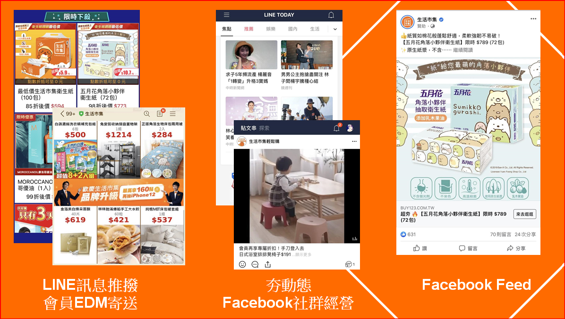
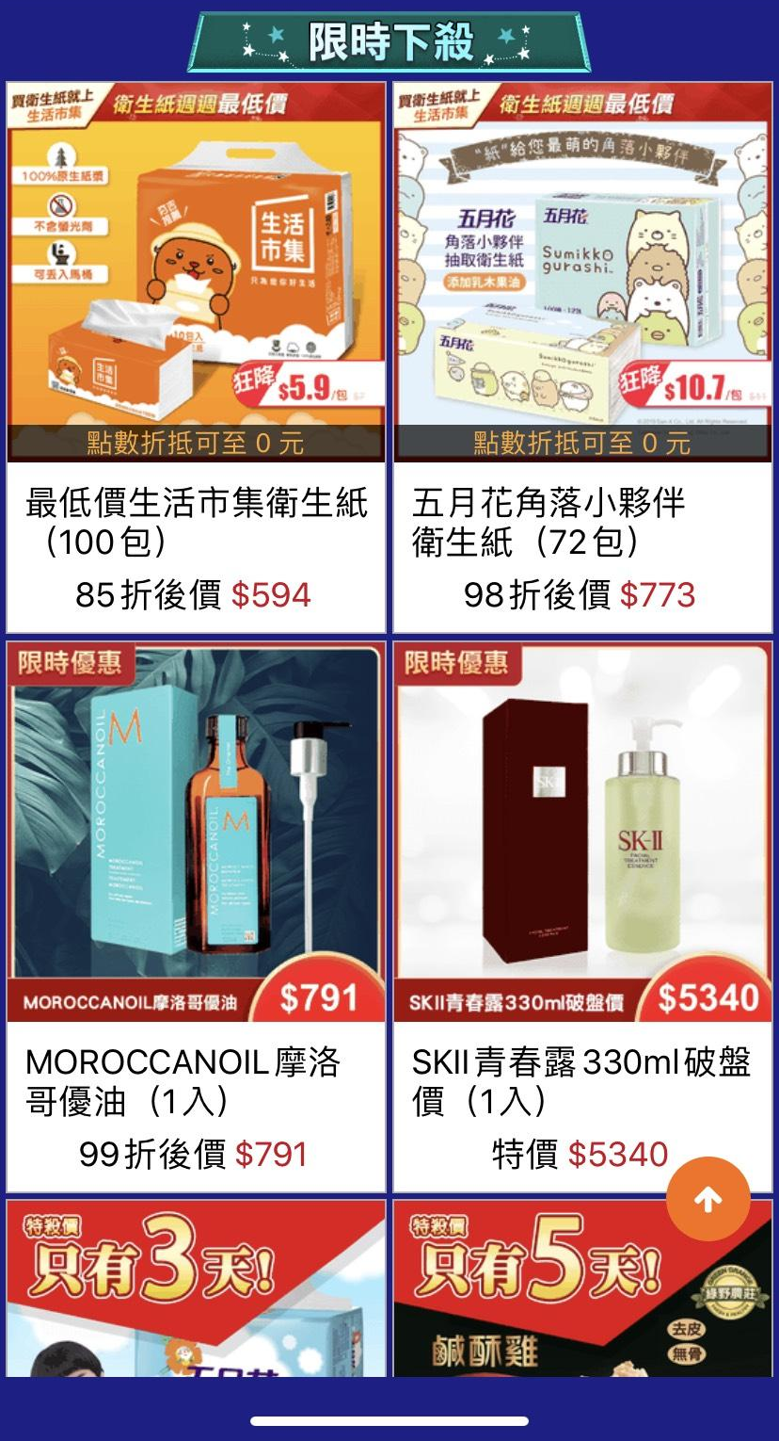
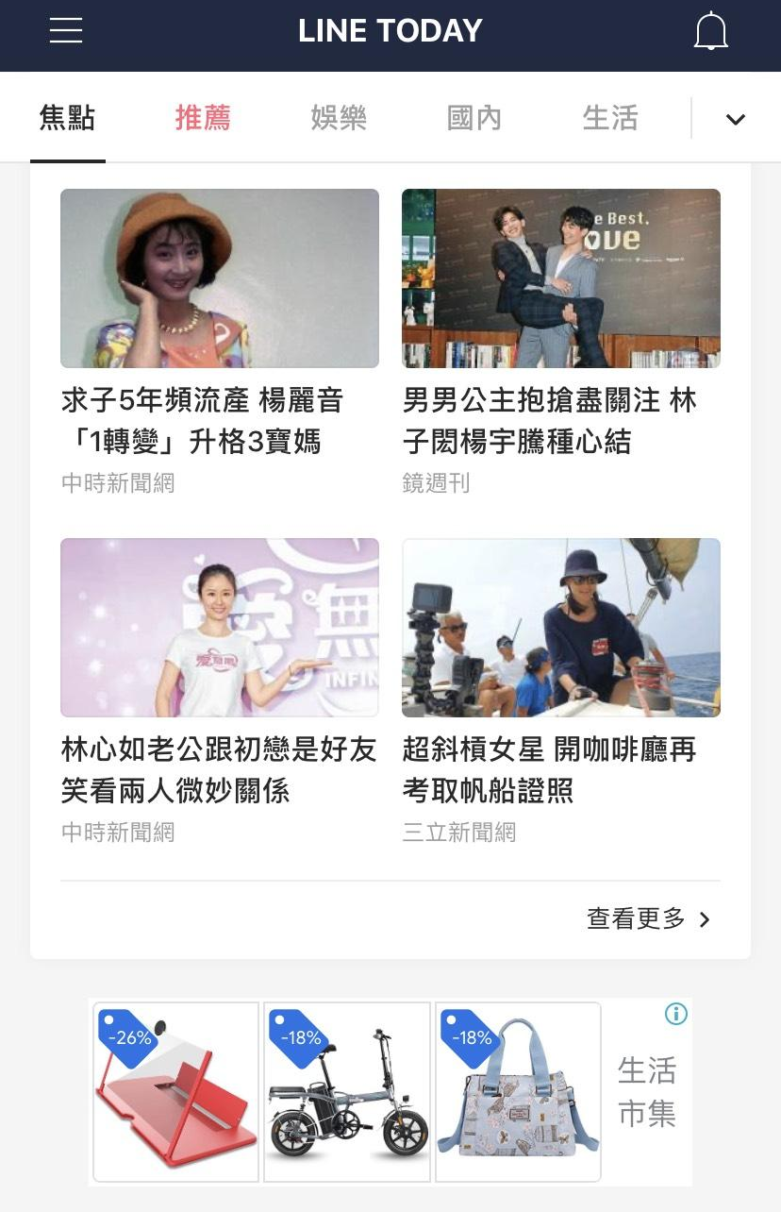
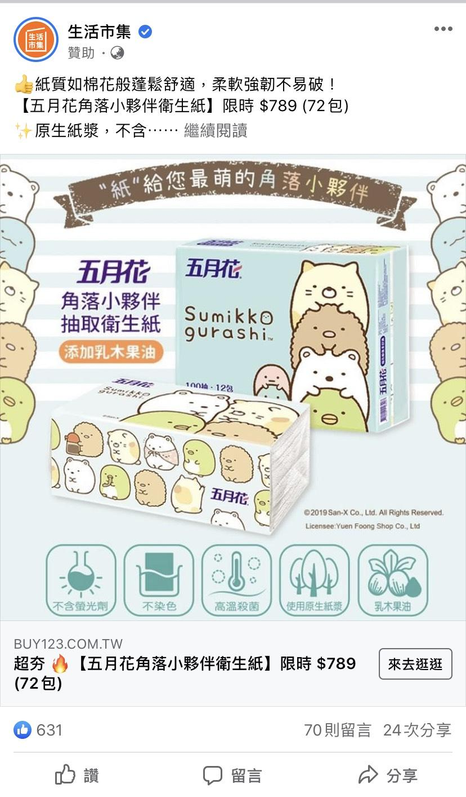
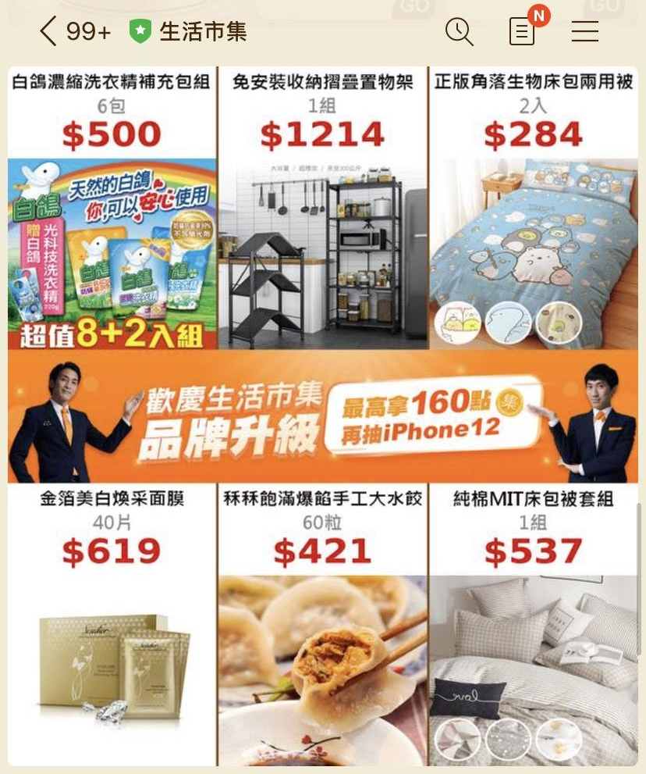
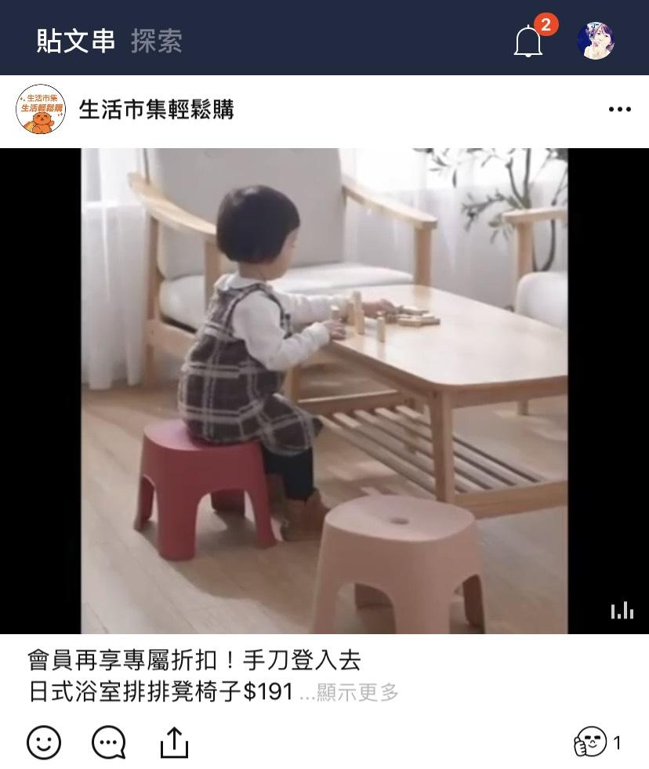
LINE Notify
Member EDM
News feed
Facebook community management
Facebook Feed
LINE Notify
Member EDM

Slide 7
Customer Demographics
About MobiX
2.1 Billion Total transaction value in 2020 92% annual growth rate!!
>70% Sales of home furnishings over total sales
Over 70% Female customers

Slide 8
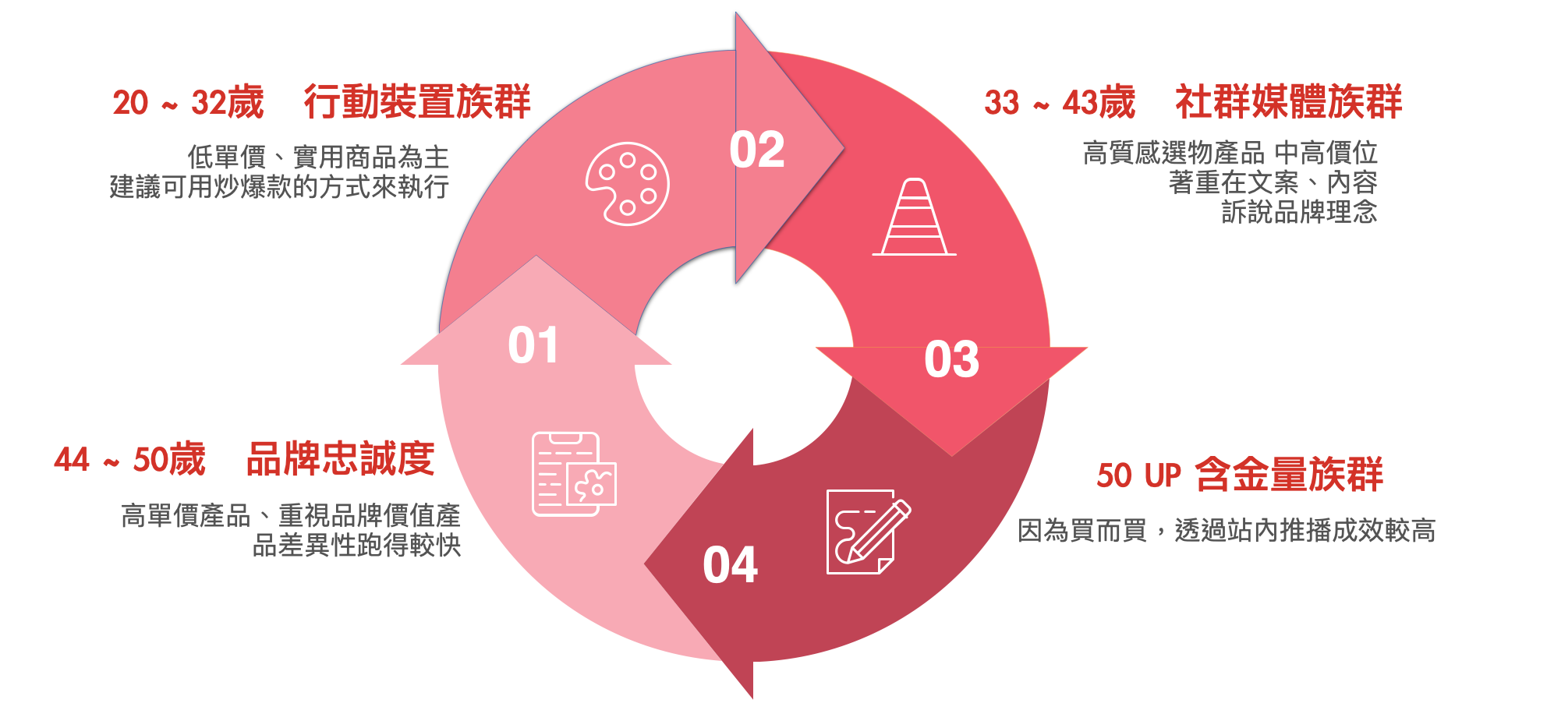
Customer Demographics
Customers of MobiX
20~32 years Mobile Device Group
33~43 years Social Media Group
Prefers high quality products in the mid-to-high price range
Recommend to place focus on copy and content to convey brand concept
Prefers low unit-price and practical products
Recommend to sell the viral products
20%
30%
44~50 years Brand Loyalty
50 years and over Deep Pocket Group
Prefers high unit price products, products emphasizing on brand value and differentiation may gain better sales.
Buys for desires, easy deals through on-site notifications
30%
20%

Slide 9
MobiX sales by category
Furniture, beddingand home decor 30%
Furniture, household items, mattresses and bases
Bedding, kitchen, and bath
Household items 30%
30
Cabinets, boxes, shelves
25
3C home appliances 30%
20
Home appliances, kitchen appliances, large appliances
15
10
Others 10%
Dietary supplements, fresh produce
05
0

Slide 10
2022Q3 Actual Business Result (P&L)
Unit: NT$ thousand | 2022 Q3 | 2021 Q3 | 2021 Q1-Q3 | 2022 Q1-Q3
Operating revenue | 531,712 | 870,129 | 1,860,958 | 2,920,076
Operating costs | 455,587 | 717,195 | 1,588,421 | 2,386,717
Gross profit | 76,125 | 152,934 | 272,537 | 533,359
Operating expenses | 105,072 | 165,398 | 362,194 | 552,779
Net operating loss | (28,947) | (12,464) | (89,657) | (19,420)
Non-operating income and expenses | 2,158 | 9,591 | 4,993 | 14,966
Net loss before tax | (26,789) | (2,873) | (84,664) | (4,454)
Net income (loss) after tax | (26,913) | 3,766 | (81,301) | 1,424
Earnings (loss) per share | (0.85) | 0.12 | (2.57) | 0.01

Slide 11
2022Q3 Actual Business Result (Balance Sheet)
Unit: NT$ thousand |  | 2022/9/30 | 2021/9/30
Current assets | Cash and cash equivalents | 243,394 | 361,673
 | Financial assets at amortized cost - current | 303,990 | 346,890
 | Accounts receivable | 36,316 | 53,430
 | Other receivables | 258 | 234
 | Current income tax assets | 3,374 | 4,529
 | Inventory | 4,523 | 5,720
 | Prepayments | 5,992 | 5,533
 | Other current assets | 6,159 | 7,494
 | Rights of return - current | 2,388 | 2,882
 | Total | 606,394 | 788,385

Slide 12
2022Q3 Actual Business Result (Balance Sheet)
Unit: NT$ thousand |  | 2022/9/30 | 2021/9/30
Non-current assets | Financial assets at amortized cost - non-current | 1,000 | 1,000
 | Property, plant, and equipment | 6,889 | 9,218
 | Right-of-use assets | 31,185 | 40,541
 | Other intangible assets | 138 | 145
 | Deferred income tax assets | 19,233 | 7,964
 | Refundable deposits | 2,904 | 2,904
 | Total | 61,349 | 61,772
Total assets |  | 667,743 | 850,157

Slide 13
2022Q3 Actual Business Result (Balance Sheet)
Unit: NT$ thousand |  | 2022/9/30 | 2021/9/30
Current liabilities | Short-term borrowings | 50,000 | 30,000
 | Contract liabilities - current | 7,108 | 6,611
 | Accounts payable | 170,319 | 222,655
 | Other payables | 58,421 | 83,352
 | Current income tax liabilities | - | 3,430
 | Refund liabilities - current | 2,628 | 3,209
 | Lease liabilities - current | 9,368 | 9,150
 | Other current liabilities | 1,744 | 1,938
 | Total | 299,588 | 360,345
Non-current liabilities - lease liabilities |  | 22,951 | 32,319
Total liabilities |  | 322,539 | 392,664

Slide 14
2022Q3 Actual Business Result (Balance Sheet)
Unit: NT$ thousand |  | 2022/9/30 | 2021/9/30
Equity | Capital - common stock | 315,928 | 315,928
 | Capital surplus | 110,577 | 240,042
 | Accumulated deficit | (81,301) | (98,477)
Total equity |  | 345,204 | 457,493

Slide 15
2022Q3 Actual Business Result (Cash Flow)
Unit: NT$ thousand | 2022 Q1 – Q3 | 2021 Q1 – Q3
Operating activities | (234,600) | (112,289)
Investing activities | 42,774 | 60,667
Financing activities | 13,078 | (38,431)
Net decrease in cash | (178,748) | (90,053)
Cash balance at the beginning of the year | 422,142 | 451,726
Cash balance at the end of the year | 243,394 | 361,673

Slide 16
Buy123 - First choice for family grocery shopping
Positioning: First choice for family grocery shopping (9 million households in Taiwan)
Price and product mix are the keys to family grocery shopping
How do we create pricing power?
First-tier brands with absolute pricing power
Second-tier and third-tier brands or unique products
Buy123 private label products

Slide 17
MobiX - the largest home decor e-commerce platform in Taiwan
Positioning: the largest home decor e-commerce platform in Taiwan
Before the end of March 2023, there will be over 150 thousand furniture and home decoration products approved to be sold on MobiX in estimation.
The “MobiX-Select” Label is expected to be rolled out in 2024.

Slide 18
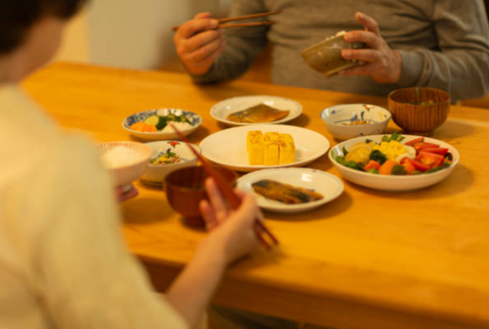
Goal and mission of MobiX
The trend in the home furnishings industry
Rituals matter in the era of border control when sales of Japanese furniture grew by over 100% annually.
According to the statistics of the Tourism Bureau of the Executive Yuan, before the pandemic in 2019, Japan was the most popular destination that attracted 33.7% of the total outbound travelers.
People started to furnish a “Japanese Lifestyle” home to pretend overseas travel, and the top trending products are dining tables and chairs, and armchairs.
2021
Sales of Imported Japanese Furniture
88%
2020
Source: Statistics of New World Design Center

Slide 19
Goal and mission of MobiX
Potential of Home Furnishings Market
Fine furniture, bedding, and home decor will become the trends of the industry.
Three major trends shown in 2020-2021 purchases, polarization in spending in the furniture market, and the M-shaped consumer spending;
Rise of the imported Japanese furniture market where the sales drastically grew by 88%
Easy home with us
Sales of mattresses grew by NT$11 million
Imported sofas priced over NT$150,000 are on the bestseller list whereas entry-level modern sofas lost the sales momentum; however, sofas in the price range of NT$50-80K are still in favor with the middle class. As a result, spending in the furniture market is polarized while the future of top-end exquisite furniture remains promising.
Accessories
Sales of top end modern sofas grew by NT$15 million
Kitchen
Furniture
Top-end modern sofas are the best performer in the imported furniture category in 2021 whereas the annual sales of entry-level modern sofas declined by over 30%. Although the sales of entry-level modern sofas dropped, the sofas in the range of NT$50-80K remain a favorite of the middle class.

Slide 20
Goal and mission of MobiX
Home furnishings customers
01
02
03
First-time homebuyers
Long-term tenants
Extended families
They need an e-commerce platform which provides home furnishing products at once! !

Slide 21
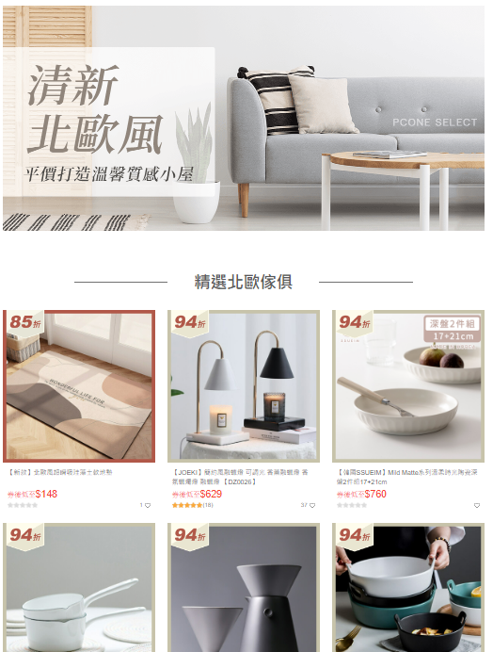
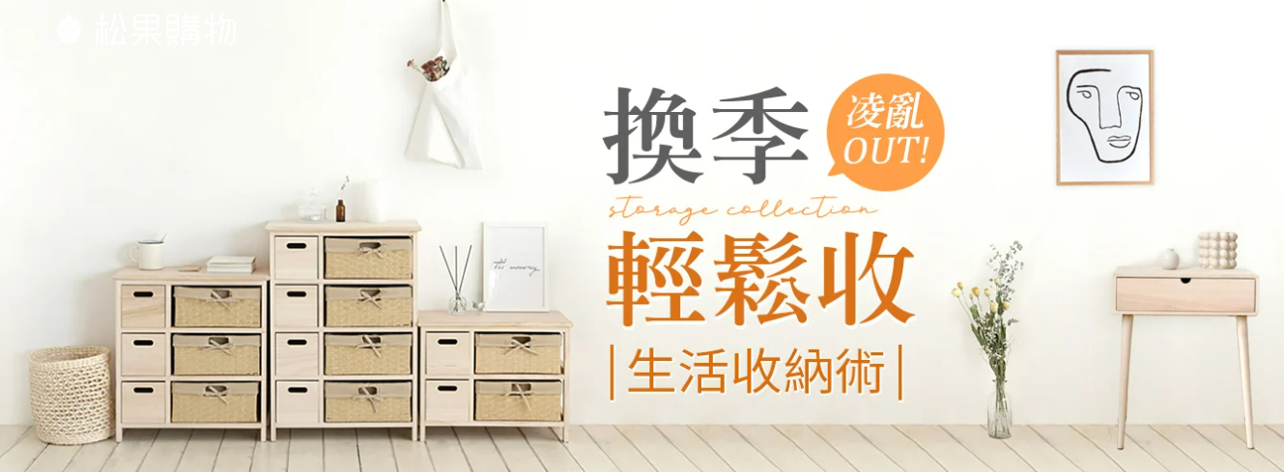
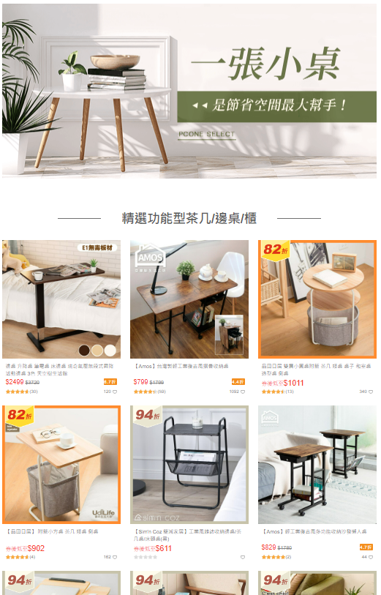
Goal and mission of MobiX
Goal and mission of MobiX
A professional e-commerce platform that includes all furniture/home decor/household products for Taiwan

Slide 22
Q & A

